Slide 1
Alexandria IP
Concept Review
June 3rd 2025
Product Development & Roadmap Forum

Slide 2
Alexandria Concept Approval (CA) - RACI
R | A | C | I
Recommender Evaluates multiple options and presents option(s) that best supports the stated objectives | Accountable Decider Ultimately answerable for success or failure of the decision. | Consulted Provides data or expertise to assess options | Informed Stakeholders responsible for acting on the decision
Aniket Saha (Product Management) | Jim Keller | Aniket S (Product Management) Tiffany Y (Legal) Andy Wall (Compliance - Trade, FIPs, external IP, FUSA) Erik G (Finance) Jason G (PMO) Divyang (Software) Divyang (Engineering - Pre & Post Si) Dan (Engineering - PD, DFT) Stakeholder sheet for signoff | Katy C (HR & Recruiting) Tanya B (Supply Chain)

Slide 3
Alexandria Stakeholder Sign-off
Role | Name | Approved (Y or N or NA) | Comment
COO | Keith Witek
CSO | David Bennett
CMO | Christine Blizzard
PMO | Jason Gunderson
Prod Mgmt | Aniket Saha
Auto Prod Mgmt | Thaddeus Fortenberry
Supply Chain | Tanya Bischoff
IP Engineering | Divyang Agrawal
Architecture | Wei-Han Lien
Phys Eng | Dan Bailey
SOC Engineering | Mike Smith
Post-Si/Sys Engr/FW | Milos Trajkovic
Silicon Eng | Dave Johnson
SW | Divyang Agrawal

Slide 4
Agenda
Executive Summary
Value Proposition
Alexandria Bounding Box
Alexandria High-Level Schedule
Alexandria Block Diagram & Key Feature Asks
Cost/Resource Summary
Tools Summary
Opens
Risks
Recommendation

Slide 5
Concept Approval Checklist
 | Owner | Status | Comment
Final Business Case complete | Troy
MRD 1.0 | Eric Z |  | Expect small number in Jama for ALX specifically
Bounding Box initial feasibility complete | Andy |  | Rae and Andy to review updates / schedule review with eng team.
Legal checks no red flags | Alicia S
Compliance (Trade, FUSA, FIPs ,& other large security aspects known) checks no red flags | Andy W |  | Rae will double check and add slide to deck with all items.
PRD 0.5 | Troy |  | Currently in spreadsheet format, moving to Jama. Need to simplify current list and move items to HW req.
Licensing for HW and SW evaluation level complete | Alicia S |  | Andy to check with Terry
Spec 0.5 Complete & Architectural feasibility complete | Alex |  | Required features are in the specs. maintaining gap analysis from ASC features. Negotiating features vs. schedule w/ RV team.
HW Engineering understand the business ask | Div
SW Engineering understand the business ask | TBD
Tops down schedule complete(should be within 20% of P&C) | Andy
Resource profile established (should be within 20% of P&C) | Priti/Andy
Preliminary financials(Cost/Spend) done to include cost estimates | Erik G
Safety Plan | Sai

Slide 6
Value Proposition
Slide Owner: James
Strategic Value/Target Customers
Enable Automotive customers to migrate from Arm to RISC-V
Computing power to serve as a base IP
Base die and chiplet applications on centralized compute, ADAS and IVI.

Slide 7
Executive Summary (Pre-Concept Approval)
Slide Owner: James/Rae
What (IP Product)
Alexandria will be Tenstorrent’s first generation high-performance RiscV IP for Automotive applications with ASIL-D certification. To be used in Robotics SoCs including ADAS/AV. ​
Why (Strategic Value)
Automotive IP customers looking for alternative to Arm Cortex-AE cores ​ Automotive ecosystem needs high-performance RiscV alternative​
Product Schedule Ask
Beta | Jan 2026
Limited Access (LA) | Mar 2026
Early Access (EA) | June 2026
General Access (GA) | TBD (>= EA + 90 days)
STL Availability | TBD
Who
RiscV CPU Team, FuSa Team, SW Team​ ResilTech
How
Functional safety related features, components and Arch enhancements added to Ascalon Auto compliant System IP Estimated burdened cost - $30M

Slide 8
Alexandria IP Bounding Box
Item |  | Pre-Concept Working Product Ask | Comments
SCHEDULE | Beta | January 2026 | Eng trend: Beta: June 30, 2026 LA: Aug 30, 2026 EA: Oct 30, 2026 GA: EA + 90 days
 | LA | March 2026
 | EA | June 2026
 | GA | >= EA + 90 days
PROGRAM COST | LA | NA
 | EA | NA
 | GA | NA
DIE SIZE / AREA | Cluster | 9.85 mm² @ N3A | 28.07 mm² @ N3A (engg estimate for 4c4MB cluster 14.97 mm² at SF4X)
 | 1 Core | 1.16 mm² @ N3A | 1.39 mm² @ N3A
FREQUENCY | Core | 2.0 GHz @ N3A (-40C to 125C Tj, SS, Vdd = Vnom - 10%) | ASC = 2.5 GHz @ SF4X = 3GHz @ N3P (scaled); N3A = N3P - 23% = 2.25 GHz at TT; TT to SS ~-35% = 1.5GHz
PERFORMANCE | IPC | > 20 SPECint 2006 / GHz, > 2.1 SPECint 2017 / GHz > 14 DMIPS (base) | With SW Opt
POWER | 1 Core + 1/4 SC Static Power | 1.69 W Dhrystone 3.4W Virus | Aria: 25 mw per sq mm max @wc condition​.
 | 1 Core + 1/4 SC Dynamic Power | 0.51/GHz Dhrystone 0.95/GHz Virus | Aria: 0.51/GHz Dhrystone​, 0.95/GHz Virus​
FEATURES | Configurations | Lead config: 4 ALX X (D8) cores with 4 MB shared L2 cache per cluster P0: 8 core, 12 MB L2 P1: 2 core, 4 MB L2 {Remove Split-Lock) | Aria: 3 x 4 core 4 MB L2 coherent clusters System IPs (IOMMU, APLIC MMCAB) to meet same delivery schedule
Notes:
Jul 21 Todo
[Aniket/Robotics team] Human Resource and Cost Analysis on removing split lock
[Troy] Confirm with RnD the Power, Performance
Base-Die Schedule Need
[Troy] Need to check with Engineering on Comments dates and without split-lock

Slide 9
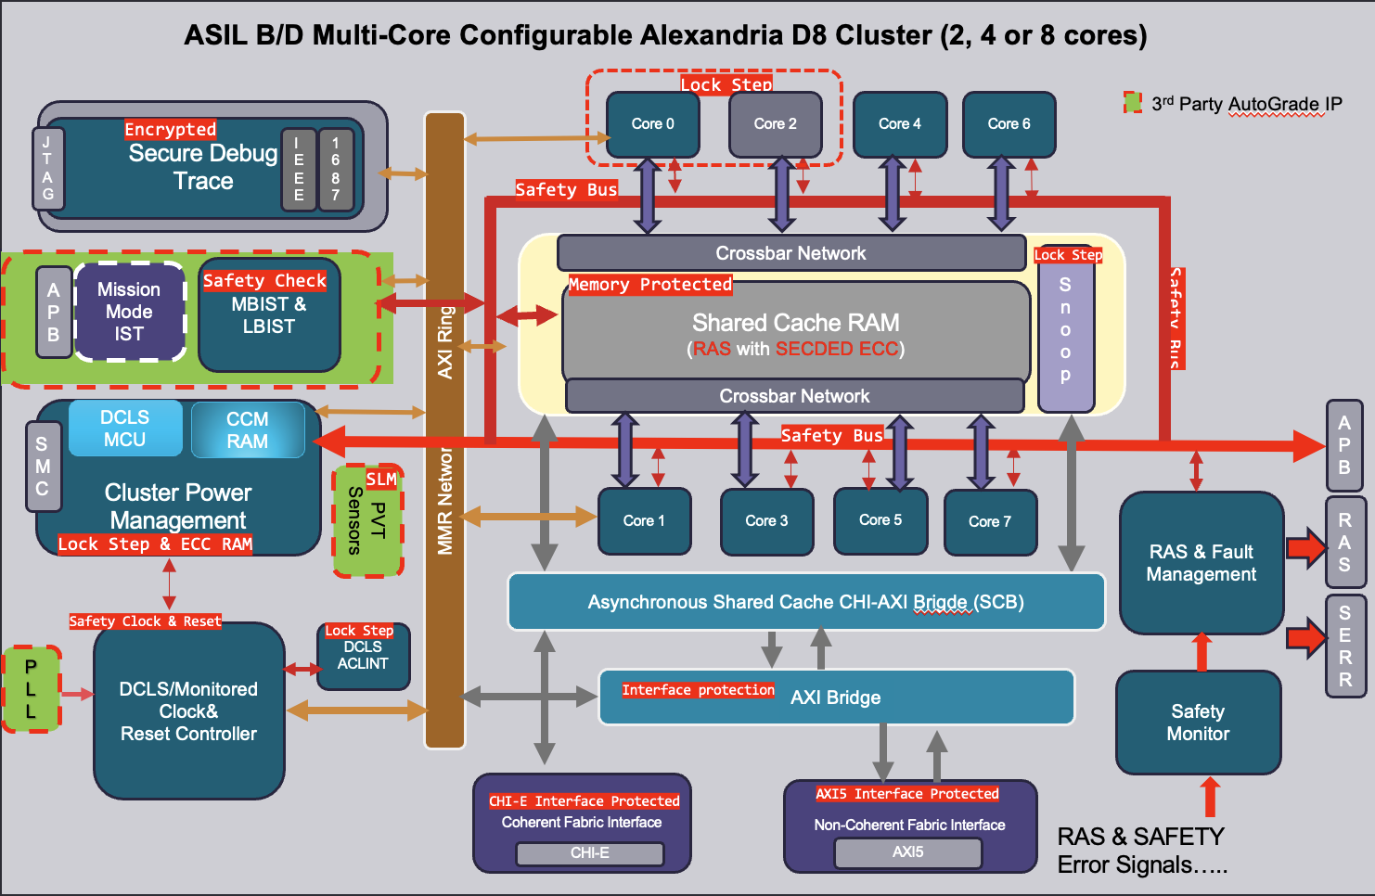
Alexandria - Block Diagram
Shown as 8 Core D8 with 12MB cache
Slide Owner: Meera
Key Features
Supports split, lock & hybrid modes
IP configurable to 2c 4MB, 4c 4MB, 8c 12MB

Slide 10
Alexandria - Safety feature & Safety Plan (DRAFT)
Safety Case
Safety Manual
kickoff
MRD, USE cases, AoU’s
Safety Concept Release v0.5
Hardware safety requirements
Aug ‘25
Feb ‘25
Mar ‘25
June ‘25
July ‘25
Jan ‘25
Mar ‘25
June ‘25
July ‘25
Safety Plan
Certification body Selection
PRD
Safety Analysis ( FMA, DFA),Verification Strategy
Safety Features
Hierarchical power management and Safety boot support with safety bus interfacing to System Management Controller
(SMC) or External Safety Manager.
Safety check on SRAM health with Memory BIST & Logic BIST during key on/key off via APB interface
Boot-time configurable Dual Core Lockstep option for Alexandria CPU cores to support LOCK mode for ASIL D, or HYBRID
mode for ASIL B or SPLIT mode for QM (Quality Management).
Lock step for Shared Cache controller, Cluster Power, Interrupt Controller
RAM protected by Parity and SECDED ECC.
Bus and Interface protection for Intra-cluster network.
Advanced RAS architecture support for Fault management and Silicon Lifecycle Management.
HW assisted Latent Fault Tests.
Software Test Library (STL).
Transient Fault Protection.
Secure debug features.
Assumptions of Use (AoUs) for SOC integration.
Variants
2 cores 4MB ,4 cores 4MB , 8 cores 12MB with L2 Shared cache
Primary Safety Mechanisms
Parity protection
SEC-DED ECC
SED-DED EDC
Secondary Safety Mechanisms
SW based (STL) Memory checks
LBIST (3P)
MBST (3P)

Slide 11
Alexandria - SW Safety
Slide Owner: WeiRen

Slide 12
Alexandria - Safety features
Slide Owner: Sai
Safety features | Why | RTL | DV | PD | DFT | SW
 | ASIL- B | Y | Y | N | N | N

Slide 13
Alexandria - Feature List (Cluster)
Slide Owner: Meera
What | Why | By when | Risk | Risk/Comment
Dual Core Lockstep | ASIL-D | Beta | G | Some risk to DV complete by Beta
Parity protection of arrays in CPU and SC | ASIL-B | Beta | G | Some risk to DV complete by Beta
Channel Parity protection for intra-cluster channels | ASIL-B | Beta | Y | Impacted by ASC late block RTL resource availability
CHI and AXI cluster IO parity protection | ASIL-B | Beta | G
RAS reporting of FuSa Errors | ASIL B&D | LA | G | RAS definition not expected done in time for beta
Security features (vDefer from ASC) | Functional | Beta | G | (Part of enhanced feature set)
Hardware Fault Injection (FE, LS) | RAS | LA | Y | RTL not yet resourced and is on ASC late blocks
L1D and TLB cacheline lock out | FuSa | Beta | R | Requires significant testing.
Cluster design changes to support In-System BIST | FuSa | LA | R | Implementation, boot time, PDN impact to be analysed

Slide 14
Alexandria - System IP (Features)
Slide Owner: Kiran
What | Why | When | Risk | Comments
Reset Controller: Clock, Reset and isolation controls per isolation/harvest/BIST domain | ASIL-B&D | Beta | G
Clock Controller: Clock monitors for PLL clock | ASIL-B&D | Beta | Y | PLL placement int vs ext to be finalized
TempHub Controller: Silicon Lifecycle Management(PVT) | ASIL-B&D | Beta | Y | Sensor placement int vs ext to be finalized
DCLS for Power Management components | ASIL-B&D | Beta | Y | SMC requirement to be finalized
ACLINT: DCLS Support | ASIL B&D | Beta | G
APLIC: DCLS Support | ASIL B&D | Beta | G
AXI Bridges: I/F and MMR parity | ASIL B&D | Beta | G
Debug: Domain isolation | ASIL B&D | Beta | G
Trace: Domain isolation | ASIL B&D | Beta | G
IOMMU: Parity protection for memory structures | ASIL B&D | Beta | Y | Resourcing not available for FuSa work yet

Slide 15
Alexandria - DV_Phase1 (ASIL-B/D compliance)
Slide Owner: Kiran
What | Why | When | Risk | Comments
Finalize the models 4c_4M & 8C_12M | ASIL-B&D | Beta | G | Priority1 - 4c_4M Priority2 - 8c_12M
Pre work related to tools VC-ZOIX | ASIL-B&D | Beta | R | Resource availability
Validate the flows : DCLS | ASIL-B&D | Beta | R | Resource availability
Validate the flows : One hot FSM | ASIL-B&D | Beta | R | Resource availability
Validate the flows : Parity support | ASIL B&D | Beta | R | Resource availability
Testbench support | ASIL B&D | Beta | R | Resource availability
Documentation using Jama | ASIL B&D | Beta | Y | Integrating the simscope and coverage data
Regression health | ASIL-B&D | Beta | Y | Waiting for Ascalon regression health
Coverage metrics | ASIL B&D | Beta | Y | Waiting for Ascalon coverage feedback

Slide 16
Alexandria - DV_Phase2 (New features)
Slide Owner: Kiran
What | Why | When | Risk | Comments
I-Cache coherency/CC4 shutdown | ASIL-B&D | Beta | G | Feature will be deferred for Alexandria
Side channel attacks | ASIL-B&D | Beta | R | DV work needs to be scoped in detail
Cache line lock execution | ASIL-B&D | Beta | R | Feature spec is in progress
Fabric (Arteris/Baya Integration) | ASIL-B&D | Beta | R
IOMMU Debug/perf features | ASIL B&D | Beta | R | Challenged on resource BW
Multi cluster models | ASIL B&D | Beta | G

Slide 17
Alexandria - Verification (System IP)
Slide Owner: Kiran
What | Why | When | Risk | Comments
Reset Controller: Clock, Reset and isolation controls per isolation/harvest/BIST domain | ASIL-B&D | Beta | R
Clock Controller: Clock monitors for PLL clock | ASIL-B&D | Beta | R
TempHub Controller: Silicon Lifecycle Management(PVT) | ASIL-B&D | Beta | R
DCLS for Power Management components | ASIL-B&D | Beta | Y
ACLINT: DCLS Support | ASIL B&D | Beta | Y
APLIC: DCLS Support | ASIL B&D | Beta | Y
AXI Bridges: I/F and MMR parity | ASIL B&D | Beta | Y
Debug: Domain isolation | ASIL B&D | Beta | Y
Trace: Domain isolation | ASIL B&D | Beta | Y
IOMMU: Parity protection for memory structures | ASIL B&D | Beta | R

Slide 18
Alexandria - Emulation
Slide Owner: Kiran
What | Why | When | Risk | Comments
Accommodate size changes | ASIL-B&D | Beta | G | Need to figure it if more HDW is required
Support fault injection (VCZOIX tool) | ASIL-B&D |  | G | Only supported on Zebu
Run STL code | ASIL-B&D |  | Y | STL is still under development and other requirements are unclear
Collect coverage for compliance metrics | DV Quality |  | Y | Will require some development and will eat Zebu capacity

Slide 19
Alexandria - Physical Design
Slide Owner: Rama
What | Why | When | Risk | Comments
Finalize PnR tool compatible with FE for automotive | FuSa | July | G
Automotive flow enablement for PD | ASIL-B&D | Alpha | Y
Target 2.25 GHz for CPU IP | ASIL-B&D | LA | Y
Validate the area and performance scaling from SF4 to N3A | ASIL-B&D | Beta | Y
First time automotive PD implementation with new flows - learning curve | FuSa | LA | Y
Tighter automotive requirements for Reliability (AEQ-100) needing additional effort | FuSa | LA | Y
4C+4MB configuration is the lead product, different from 8C+12MB getting implemented now - New FP | Aria | LA | Y | Only one of the configuration can be supported with current staffing
Impact of LBIST on area / performance needs to be assessed | FuSa | LA | Y
Certification requirements / reviews / data generation | FuSa | LA | Y

Slide 20
Alexandria - DFT
Slide Owner: Sachin B

Slide 21
Alexandria - DFT
Slide Owner: Sachin B
What | Why | When | Risk | Comments
DFT EDA tool decision | ASIL-B&D | Beta | Y | Tessent based flow being assessed
Clock Controller: Clock monitors for PLL clock | ASIL-B&D | Beta | R
TempHub Controller: Silicon Lifecycle Management(PVT) | ASIL-B&D | Beta | R
DCLS for Power Management components | ASIL-B&D | Beta | Y
ACLINT: DCLS Support | ASIL B&D | Beta | Y
APLIC: DCLS Support | ASIL B&D | Beta | Y
AXI Bridges: I/F and MMR parity | ASIL B&D | Beta | Y
Debug: Domain isolation | ASIL B&D | Beta | Y
Trace: Domain isolation | ASIL B&D | Beta | Y
IOMMU: Parity protection for memory structures | ASIL B&D | Beta | R

Slide 22
Alexandria - Software
Slide Owner: Olof

Slide 23
Alexandria - Application Engineering
Slide Owner: Troy
Suggestions
Go to Market Plan
Customer Engagement/Collateral Deliverable/Support plan
Early access customer list/feature support/

Slide 24
High-Level Schedule
Slide Owner: James/Aniket/Meera/Kiran
Next Steps | Schedule Ask (Product) | Schedule Trend (Execution team) | Comments
Beta | Jan 15, 2026 | June 30, 2026 | (RTL 0.8 quality)
Limited Access (LA) | March 31, 2026 | Aug 30, 2026
Early Access (EA) | June 30, 2026 | Oct 30, 2026
General Access (GA) | EA + 90 days
STL Availability | TBD
FuSa Certification | Dec 2026
Note:
Schedule proposal is not POR yet.
Execution teams will perform detailed effort estimate analysis post concept approval to provide a POR commit.
Notes:
ASR Silicon bring up in Taiwan

Slide 25
Alexandria - Cost Summary
Slide Owner: James/Sushrutha

Slide 26
Alexandria - People Resource Summary
Slide Owner: Sushrutha

Slide 27
Alexandria - Tools Summary
Slide Owner: TBD

Slide 28
Alexandria - Assumptions
Assumption | Impact if False | Owner | Checkpoint
People will move from ASC to ALX by XX date | ALX will be delayed | Ashok

Slide 29
Alexandria - Dependencies
Dependency | On Who | Impact if Missed | Owner | Checkpoint

Slide 30
Alexandria - Risk Plan
Risk Category | Impact | Risk | Mitigation Plan | Owner | CP

Slide 31
Opens
Priority | Action Item | Owner | Due Date | Status | Next Step, Comment, Resolution
P0

Slide 32
Opens / Risks
Issues | Owner | Checkpt | Status | Open
DFT RTL support | Sachin |  | R | LBIST requirements for IP and MBIST requirements for chiplet (no runtime LBIST for chiplet) need finalizing. DFT to work with Product to define.
RAS updates | Cameron |  | Y | Generate new descriptors for parity and DCLS errors
Recurring FMEDA analysis staffing / contractor | Meera |  | Y | Ask for design team to run FMEDA analysis to verify implementation based FuSa coverage. Lacks resources.
3PIP Auto-compliant versions | Alpesh |  | R | Need Aria to close on 3PIP vendors to use so that cluster RTL can plan for required interfaces & cluster PD can account for area.
RTL/DV Resourcing | Kiran/Meera |  | R | DV team currently focused on ASC with no initial exploration staffed for new fault injection tools.
Chiplet Architecture | Alpesh |  | R | Final configuration (ASIL B or B/D) and IP blocks
Tech Node | Narmadha |  | G | Technode N3A process files need to be procured.
PD Resources | Mark/Dan |  | Y | PD staffing for timing and floorplanning work for Alx.
Software Workloads | Ian |  | R | No known information about software workloads to use for characterization.
Enhanced Feature Set | Alex |  | R | Feature set beyond ASIL-B/D support adds to schedule delays of ~1Q for RTL/DV.

Slide 33
Recommendation and Next Steps
Alexandria team recommends to proceed with Concept Approval and move towards Plan & Commit.
Next Steps | Due | Owner
Bounding Box locked and aligned with Exec teams |  | Troy Jones
PRD 1.0 Complete and aligned with Exec Teams |  | Troy Jones
POR set and aligned with Exec teams |  | Alex Yap
Tools/License asks aligned with Supply Chain |  | Sushrutha V
Infrastructure support established |  | Team Reps
New Hire asks aligned with Recruiting |  | Team Reps
Cost/Funding aligned with Finance |  | Aniket Saha
Alexandria - Plan & Commit PDRF |  | Sushrutha V
Notes:
ASR Silicon bring up in Taiwan

Slide 34
BACK UP

Slide 35
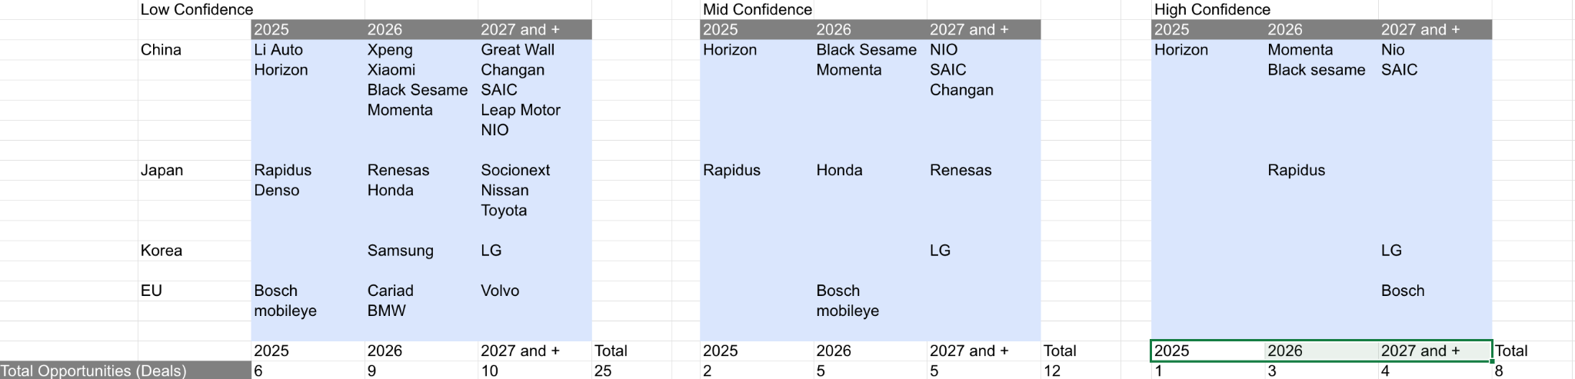
Alexandria - Business Case All
Slide Owner: James

Slide 36
Ascalon IP timeline
Jan 30, 2025
Jun 30 2025
Oct 31, 2025 (Proposed)
Oct 30, 2026
Asc Auto (Alexandria)
EAC (Design Freeze)
ASIL-B and ASIL-D
FuSA Compliance – complete
2.5GHz
Asc (non-auto)
Beta with ER support
(not all features enabled)
2.25GHz (+/- 5%)
Asc (non-auto)
LAC (DV Complete)
2.5GHz (+/- 5%)
Asc Auto (Alexandria)
Initial Alpha Drop
4c 4MB ASC with no FuSa
Asc (non-auto)
Beta
2.25 GHz
Asc (non-auto)
EAC (Design Freeze)
2.5 GHz
Asc Auto (Alexandria)
LAC (DV Complete)
ASIL-B and ASIL-D (tentative)
FuSA Compliance – pending
2.5 GHz
Babylon
EAC (Design Freeze)
Multiple variants
Spec2K 20
2.7GHz
Apr 30, 2025
Aug 31, 2025
Aug 31, 2026
Aug 31, 2026 (Proposed)
Bottom up schedule is based on:
Resource availability for design & verification
Tech node availability by start of Q4’25
Successful engagement with Synopsys for verification

Slide 37
Alexandria Features (Delta over Asc)
Slide Owner: Meera
Features | Source | Description
Cluster to support Split/Lock modes | MRD | Cluster will be designed as configurable to operate as Hybrid or fully Lockstep to meet different ASIL requirements.
Target node TSMC N5A | MRD | FuSa certified process requirement for appropriate placement guidance
Core, SC, Cluster to offer ASIL-B support | PRD | Various structures in the Asc cluster will be covered by parity insertion. CHI and AXI channels will offer parity protection.
Core, SC, Cluster to offer ASIL-D support | PRD | Cores will support lockstep, SC control logic will be duplicated, various blocks like reset controller, will be duplicated or updated for ASIL-D certification
FuSa errors aggregation and reporting | PRD | Design will aggregate FuSa errors and adhere to requirement for max latency between detection and reporting at cluster level.
Flex configs: 8c 12MB, 4c 4MB, 2c 4MB | MAS | In order to meet 4MB cache requirement for Aria, SC will shrink from total 16 slices to total 8 slices, and new placement style.
3PIPs need auto-compliant versions | PRD/Aria | TT not responsible for FuSa qualification of 3PIP
Open Source code needs auto-compliance / verification | Compliance

Slide 38
Verification Deferred Features (Same as for Asc)
Slide Owner: Kiran
Features | EAC Commit | Proposed Out of Scope for EAC
Side channel attack mitigation | RTL Coding and dtests enabled Side-channel workloads enabled | Full random regressions signoff crosses with other features
Silicon debug / workaround: Token Leak detection | RTL coding complete, basic dtests enabled | Full random regressions
Silicon debug / workaround: Patch RAM exceptions | RTL coding complete, basic dtests enabled | Full random regressions
Sdtrig-Icount | RTL coding complete, basic dtests enabled | Full random regressions
CRB approved Perf Enhancements <list> | RTL coding complete, basic dtests enabled, Ralph tests enabled | Full random regressions, chicken bit enabled
Deferred features need to be reviewed by Arch Team and signed off for Alexandria

Slide 39
Alexandria Core Team
Role | Core Team Representative
Alexandria Product Program Manager | Rae Parnmukh
Automotive Product Manager | Eric Zhang
CPU IP Product Manager | Troy Jones
Architecture TPM | Pragna Paranji
Architect | Alex Yap
FuSa Safety Manager/FuSa Safety Engineer | Sainath Reddy Narayanagari
TT FuSa Process | Sam Visalli
Alexandria TPM | Sushrutha Vigraham
RISC-V Project lead (RTL) | Meera Ramani-Augustin
RISC-V Project lead (DV) | Kiran Maturu
DFT | Sachin Badole
Physical Design | Ramakrishna Ayinapudi
Software | Aren Edlund
IP Engineering Lead | Stephan Gaskins
RISC-V Cluster RTL | Bharath Poluri
RISC-V PPA | Erik Swanson
RISC-V Post Si Readiness | Sajosh Janarthanam
Firmware | Daniel DeGrasse
IP Customer Lead | Troy Jones
Global Sourcing & Supply Chain | Tom Boland

Slide 40
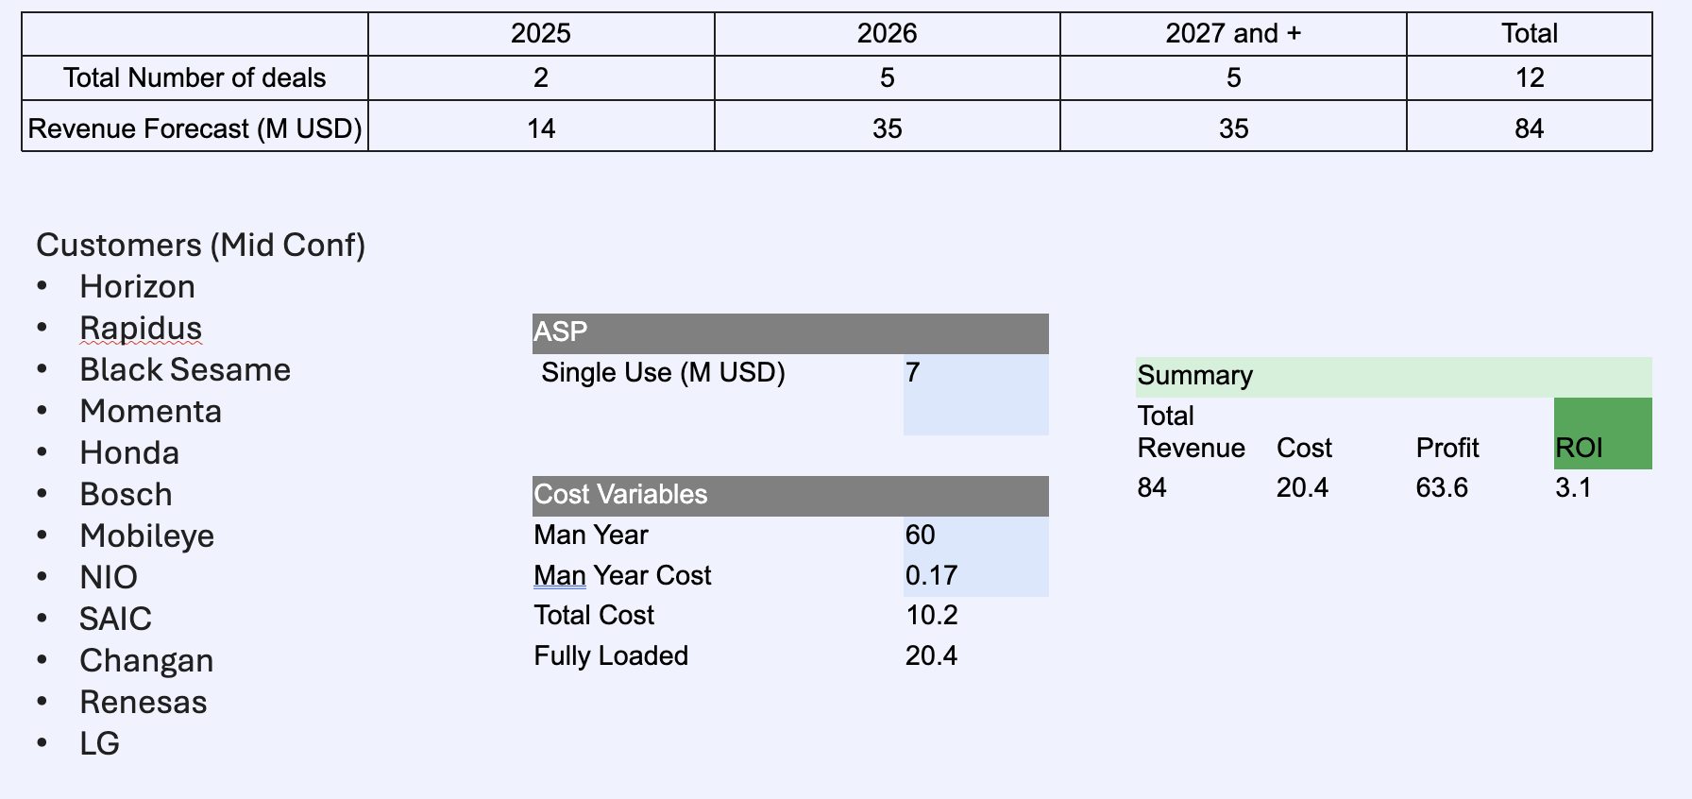
Alexandria - Business Summary (Mid Conf)
Slide Owner: James/Aniket
Work in progress

